Slide 1

Machine Learning Hackathon CG 2022
Team Name- Healers
Team Leader Name- Ankit Kumar
Team Leader Email Address- ankitkrchy.54@gmail.com

Slide 2
Brief description of the problem at hand:
Here’s what people are generally facing:
The spike in online cashless activity in recent times has lead to a large amount of people falling victim to phishing frauds as most online transactions have their dependency on sms’s.
A survey showed that in 2019, 60% of SMS users received spam messages once a week, and 28% almost every day.
The year 2021 has seen a sharp rise in phishing activities, where nearly 71% of phishing attacks were financially motivated, as reported by security experts. Almost 29% of breaches involved the use of stolen credentials, and nearly 33% of breaches used social engineering.

Slide 3
Solution proposed and description:
I have made multiple models and compared their performance. On basis of given dataset and other similar datasets.
The proposed solution is an android application which automatically detects the phishing in incoming messages/emails and at real time we warn the user by notification.
User can also check the credibility of any particular message by opening it in our app with graphical representation.
Under the hood, our API depends on an dynamic ML model which gets better with use by our users.
User gets the warning and can also report/forward any suspicious message to 1909.

Slide 4




Technology/Tool Stack Used:
Xgboost
Flutter
Sk-learn
Flask

Slide 5
Approach:
I have made multiple models and compared their performance. On basis of given dataset and other similar datasets.
After comparison the best model came out was Xgboost
So I started to hypertune it using random searchcv. That gave me a 99% accuracy score on test set.
So I’ve used it as a final model
After that I have created a flask api for the model.
Next steps is to complete the android app.

Slide 6
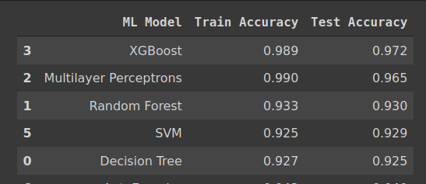
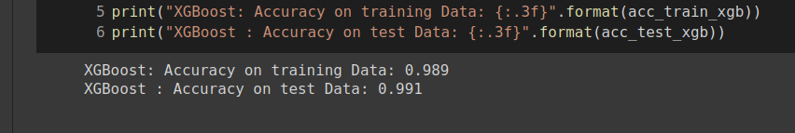
Execution Demo(Video/Screenshots) of the solution:

Slide 7
Source code as ZIP or Github URL:
https://github.com/cnarte/Phishing-detection

Slide 8
THANK YOU !!

